Slide 1

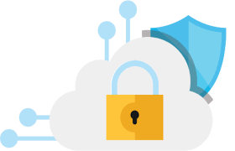
Cyber Security for Digital Devices
Issues and Challenges in Cyber Security
Name : Divesh Jadhwani
Institution : Pimpri Chinchwad University

Slide 2
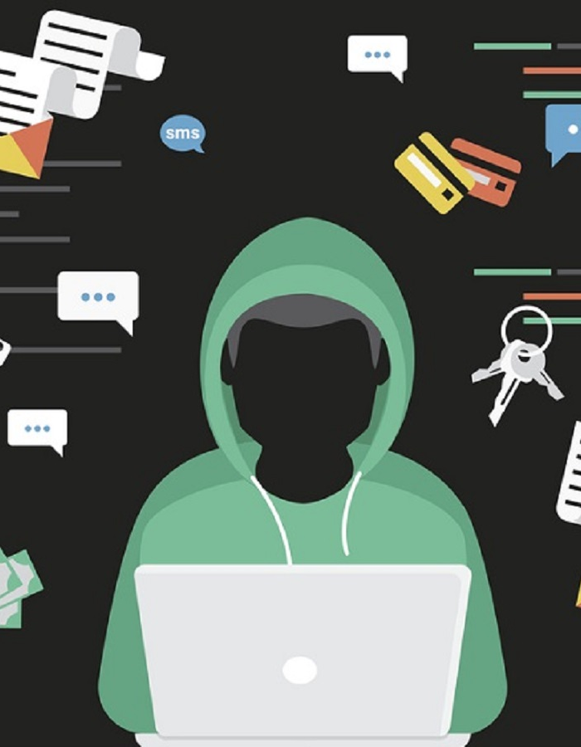
Introduction to Cyber Security Challenges
Introduction: Cyber security remains a critical concern as digital transformations continue globally.
Objective: Understand the current threat landscape, vulnerabilities, and challenges organizations face in securing their data.
Real-life Context: Everyday activities like online banking, social media, and e-commerce rely heavily on cyber security.

Slide 3

The Evolving Threat Landscape
Definition: The threat landscape refers to the current and potential threats targeting an organization’s information systems.
Explanation: Cyber threats are constantly evolving with technology.
Examples: Phishing, ransomware, Advanced Persistent Threats (APTs) (Undetectable hacker for years), IoT vulnerabilities ,Salami attack.
Real-life Example: WannaCry ransomware attack affecting hundreds of thousands of computers globally.

Slide 4
Understanding Vulnerabilities
Definition: Vulnerabilities are weaknesses in a system that can be exploited by threats to gain unauthorized access or cause harm.
Types: Software bugs, misconfigurations, human errors, outdated systems.
Real-life Example: Heartbleed bug in OpenSSL, which allowed attackers to steal information protected under normal conditions.

Slide 5
Assessing Risks
Definition: Risk is the potential for loss or damage when a threat exploits a vulnerability.
Components: Threats, vulnerabilities, impact, likelihood.
Risk Management: Identifying, assessing, and prioritizing risks followed by coordinated efforts to minimize, monitor, and control their impact.
Real-life Example: Risk assessment in financial institutions to protect against data breaches and fraud.

Slide 6

Case Study: SolarWinds Hack
Overview: SolarWinds supply chain attack impacted numerous government and private sector organizations.
Details: Attackers inserted malicious code into SolarWinds' Orion software, which was distributed to thousands of customers.
Impact: Data breaches, compromised systems, and extensive remediation efforts.
Lessons Learned: Importance of supply chain security and continuous monitoring.

Slide 7

Case Study: Colonial Pipeline Ransomware Attack
Overview: Ransomware attack on Colonial Pipeline, one of the largest fuel pipelines in the U.S.
Details: Attackers used compromised VPN credentials to access systems.
Impact: Fuel supply disruption, economic impact, ransom payment.
Lessons Learned: Importance of securing remote access points and incident response planning.

Slide 8
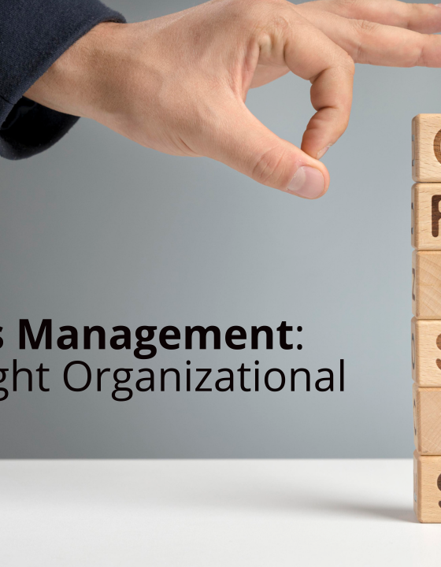
Security Policies and Frameworks
Definition: Security policies and frameworks provide guidelines and standards for protecting information assets.
Examples: NIST Cybersecurity Framework
Explanation: These frameworks help organizations establish, implement, maintain, and continuously improve their cyber security measures.
Real-life Example: Adoption of NIST (National Institute of Standards and Technology)framework by U.S. federal agencies to enhance cyber security posture.

Slide 9
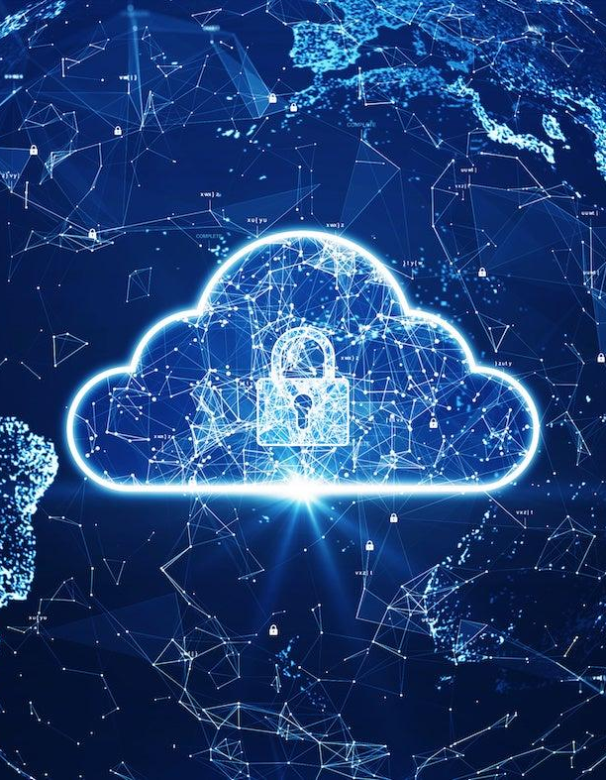
Organizational Challenges in Implementing Cyber Security
Challenges: Budget constraints, lack of skilled personnel, resistance to change, complexity of IT environments.
Explanation: Organizations struggle with prioritizing cyber security due to competing interests and resource limitations.
Real-life Example: Small businesses often face significant challenges in implementing robust cyber security measures due to limited budgets.

Slide 10
Emerging Threats and Future Trends
Emerging Threats: AI-powered attacks, quantum computing threats, deep fakes, 5G vulnerabilities.
Explanation: As technology advances, so do the methods used by attackers.Organizations must stay ahead of these trends to protect their assets.
Future Trends: Increased focus on zero trust security models, enhanced AI-driven defenses, greater regulations.
Real-life Example: Rise of deepfake technology used in social engineering attacks.

Slide 11
The Role of Artificial Intelligence in Cyber Security
Definition: AI and machine learning can enhance cyber security by identifying patterns, predicting threats, and automating responses.
Benefits: Improved threat detection, faster incident response, reduced human error.
Challenges: AI can also be used by attackers, need for high-quality data, potential for false positives.
Real-life Example: Use of AI in detecting phishing attacks and anomalous behavior in network traffic.

Slide 12
Insider Threats
Definition: Insider threats involve risks posed by employees, contractors, or business associates who have access to an organization’s systems.
Types: Malicious insiders, negligent insiders.
Mitigation: Background checks, monitoring, access controls, employee training.
Real-life Example: Edward Snowden's leak of classified NSA documents.

Slide 13
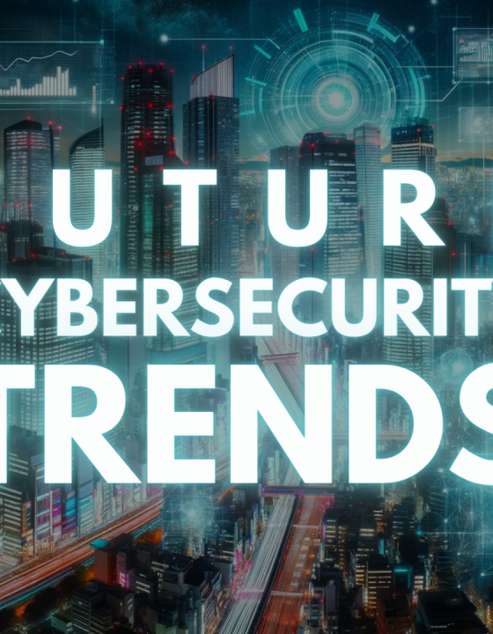
Cyber Security Awareness and Training
Importance: Educating employees on cyber security best practices is essential to prevent breaches.
Topics: Phishing awareness, password management, recognizing suspicious activities.
Implementation: Regular training sessions, simulated phishing attacks, continuous learning.
Real-life Example: Company-wide training programs reducing the incidence of successful phishing attacks.

Slide 14
Conclusion
Summary:
Cyber Security Challenges
Threat Landscape
Understanding Vulnerabilities
Assessing Risks
Case Study: SolarWinds Hack , Colonial Pipeline Ransomware Attack
Organizational Challenges in Implementing Cyber Security
The Role of Artificial Intelligence in Cyber Security
Cloud Security Challenges
Insider Threats
Cyber Security Awareness and Training

Slide 15
Quiz - Threat Landscape
• Question: What is the threat landscape in cyber security?
Options:
A) A list of outdated software
B) The current and potential threats targeting an organization’s information systems
C) The physical layout of an organization’s data center
D) A type of firewall configuration

Slide 16
Slide 17: Quiz - Vulnerabilities and Risks
Question: Which of the following is an example of a vulnerability?
A) A phishing email
B) A misconfigured server
C) A ransom demand
D) An incident response plan

Slide 17
Slide 18: Quiz - Case Study Analysis
Question: What was a major lesson learned from the SolarWinds hack?
A) The importance of regular software updates
B) The need for strong passwords
C) The significance of supply chain security
D) The benefits of antivirus software

